Slide 1






Lecture 36:
Context API
Course - Web Development - II
-By
Instructor Name
1
welcome@krmangalam.edu.in
Sohna Road,Gurugram,Haryana 122103

Slide 2

| Table of Contents
Context Api
References.
The End.
2

Slide 3

|
Have you ever wondered if we could share data directly with all components without passing it down step by step like in prop drilling?
3

Slide 4

|
Have you ever wondered if we could share data directly with all components without passing it down step by step like in prop drilling?
Yes! Big thanks to Context API,
because it allows us to share data directly with any component — without sending it step by step through props
4

Slide 5
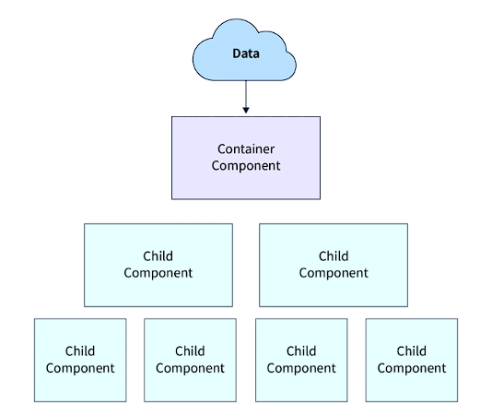
| Context api
The Context API in React is a built-in feature that allows you to share data between components without passing props manually at every level of the component tree.
It provides a way to make certain values globally available to any component, no matter how deeply nested it is.
5

Slide 6
| Context api
We will make a tiny app with a light/dark theme.
It is one of the best examples to explain Context API.
6

Slide 7
|
Have you ever thought about this —
If we want to build a Dark/Light theme in our app, and we have multiple components and pages, then how should we share the theme?
7

Slide 8
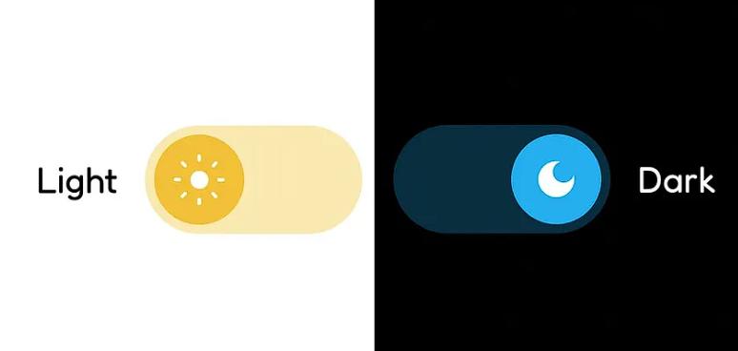
|
Have you ever thought about this —
If we want to build a Dark/Light theme in our app, and we have multiple components and pages, then how should we share the theme?
Here is two options:-
Should we create the same theme logic inside every single component separately?
should we create the theme logic once inside App.js and then pass it down as props to all components?
But wait… do you think this is the best way to do it?
8

Slide 9

|
Have you ever thought about this —
If we want to build a Dark/Light theme in our app, and we have multiple components and pages, then how should we share the theme?
Both of these methods work… But the problem is —
If we repeat the logic in every component → the code becomes very messy and harder to maintain.
If we pass props from App.js to all children → we end up with something called Prop Drilling (sending data step by step even if some components don’t need it).
9

Slide 10
|
Have you ever thought about this —
If we want to build a Dark/Light theme in our app, and we have multiple components and pages, then how should we share the theme?
What if I told you… React already gives us a better way?
Imagine if your data had a teleporter. Instead of passing it one by one, you could just broadcast it like Wi-Fi.
Then, any component on any page (Home, About, Contact, etc.) can simply connect and use it directly — without disturbing others.
That teleporter in React is called the Context API.
10

Slide 11
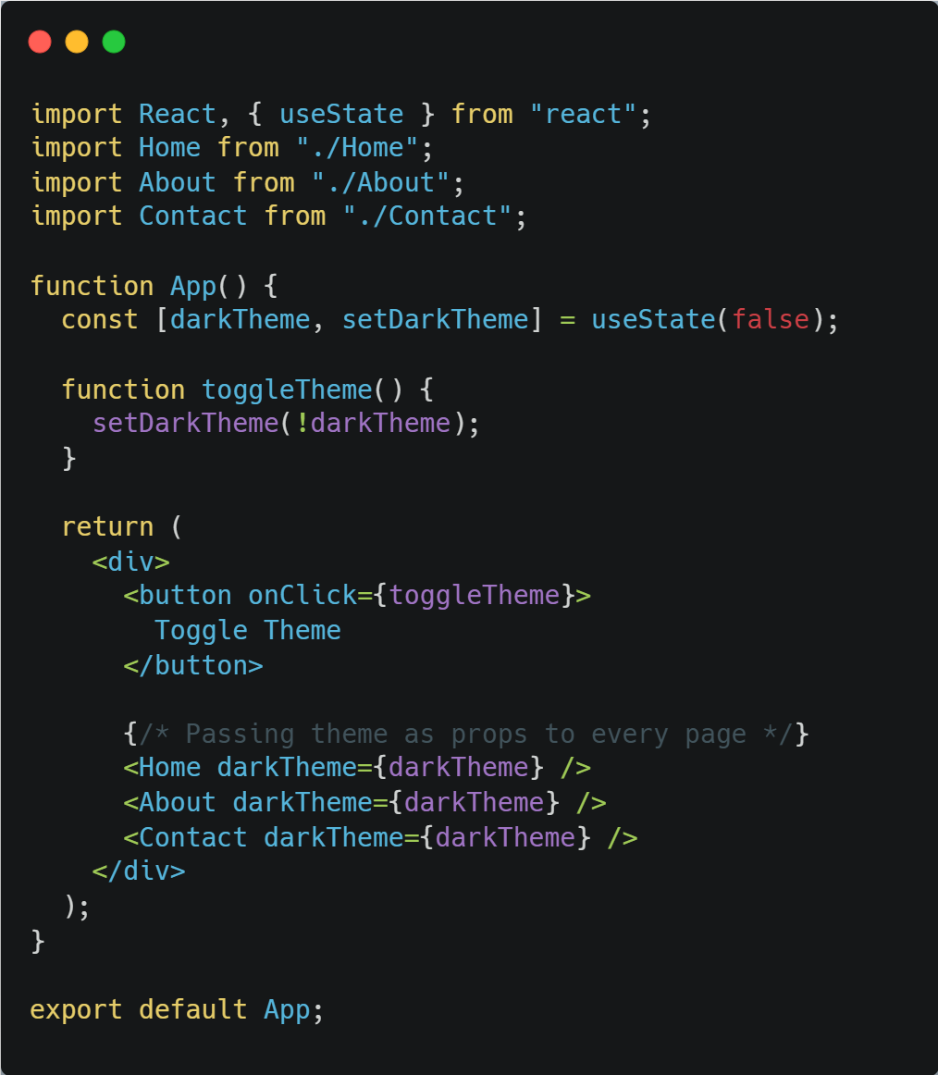
| Context api
Version 1: Without Context API (Prop Drilling)
App.js
11

Slide 12
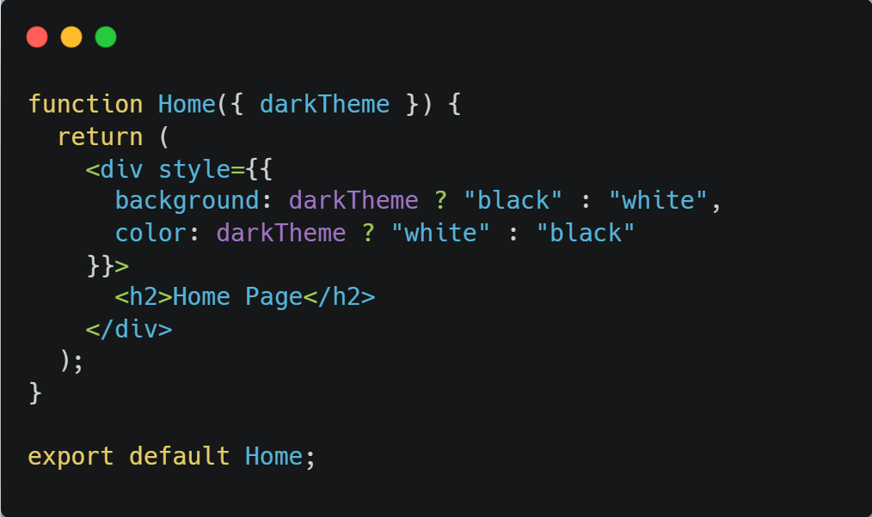
| Context api
Version 1: Without Context API (Prop Drilling)
Home.js
12

Slide 13
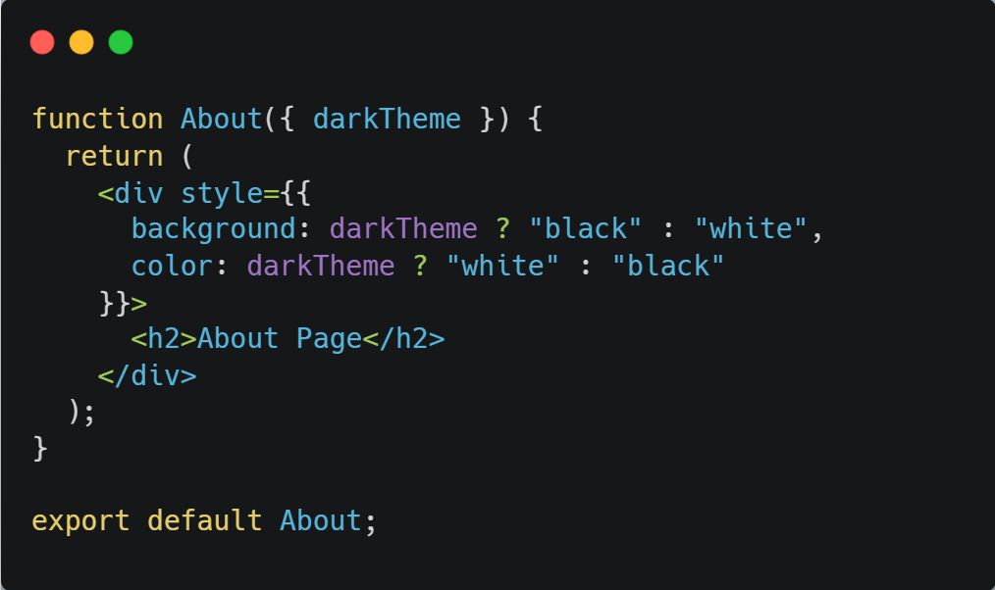
| Context api
Version 1: Without Context API (Prop Drilling)
About.js
13

Slide 14
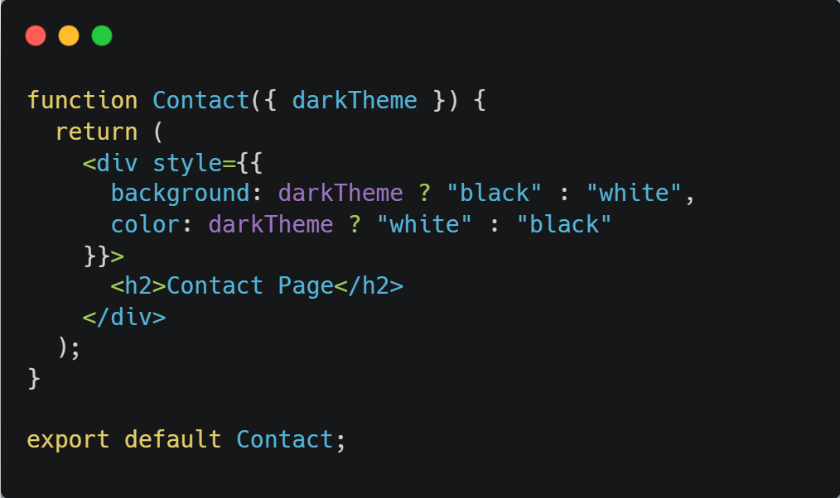
| Context api
Version 1: Without Context API (Prop Drilling)
Contact.js
14

Slide 15
| Context api
Version 1: Without Context API (Prop Drilling)
Problem:
Every component (Home, About, Contact) is forced to receive darkTheme as a prop.
If components were nested deeper, we’d have prop drilling everywhere.
15

Slide 16
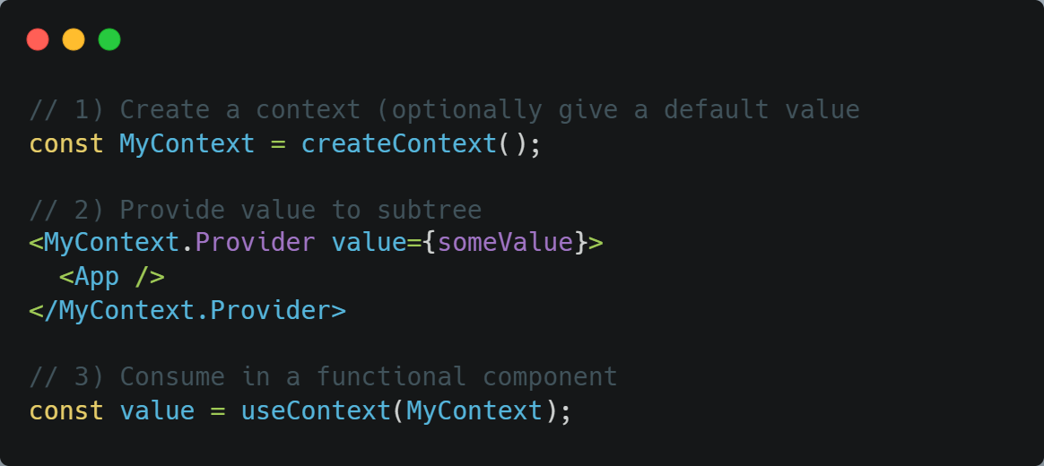
| Context api
Version 2: With Context API
Syntax :
16

Slide 17
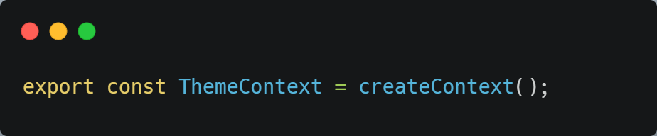
| Context api
Process of using Context Api :
createContext()
Used to create a Context object.
Example:
17

Slide 18
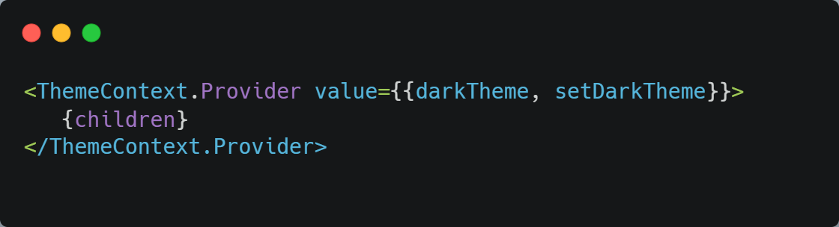
| Context api
Process of using Context Api :
Context Provider
Used to provide (share) data to all child components.
Example:
18

Slide 19
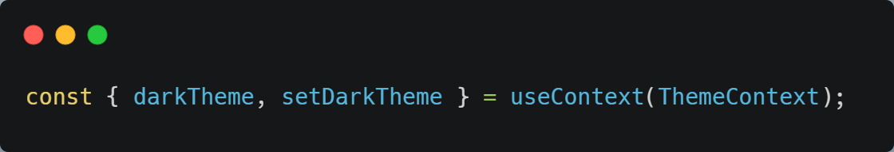
| Context api
Process of using Context Api :
useContext Hook
Used to consume (use) the data inside any component.
Example:
19

Slide 20
| Context api
Process of using Context Api :
Step 1: Create a context with createContext()
Step 2: Wrap your app (or part of it) with the Provider
Step 3: Use useContext() in child components to access data
Context API = A teleporter that sends data directly from parent to child components without prop drilling.
20

Slide 21
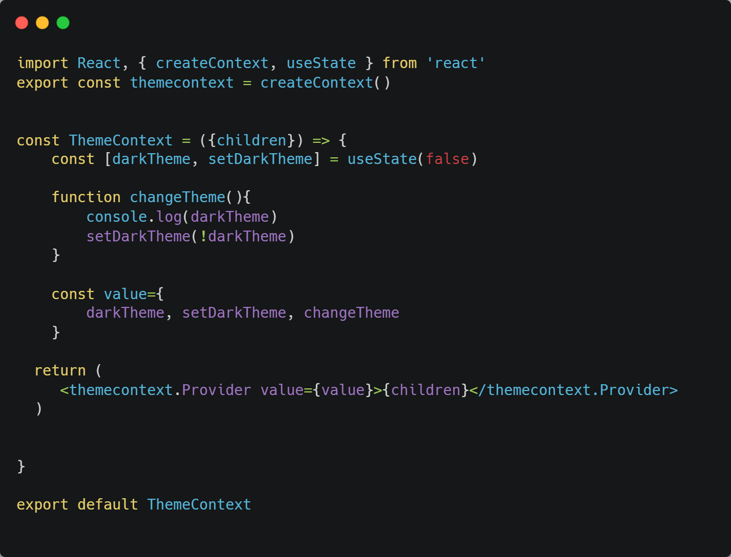
| Context api
ThemeContext.jsx
What’s happening here:
createContext() → creates a new context object (themecontext).
useState(false) → keeps track of whether the app is in dark mode or light mode.
changeTheme() → a function that toggles between light and dark theme.
value = { darkTheme, setDarkTheme, changeTheme } → all the data and functions we want to share.
<themecontext.Provider value={value}> → provides this value to all child components inside it.
This file is the source of truth for theme state and functions.
21

Slide 22
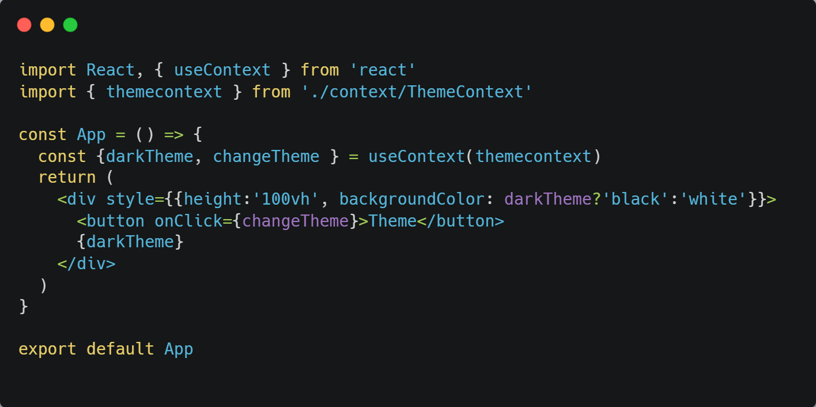
| Context api
App.jsx
What’s happening here:
useContext(themecontext) → pulls out the data from the ThemeContext provider.
{ darkTheme, changeTheme } → directly use the values we provided earlier.
backgroundColor: darkTheme ? 'black' : 'white' → dynamically changes page color based on theme.
<button onClick={changeTheme}> → toggles the theme when clicked.
{darkTheme} → shows the current theme value (true or false).
This file is the consumer that actually uses the data from context.
22

Slide 23
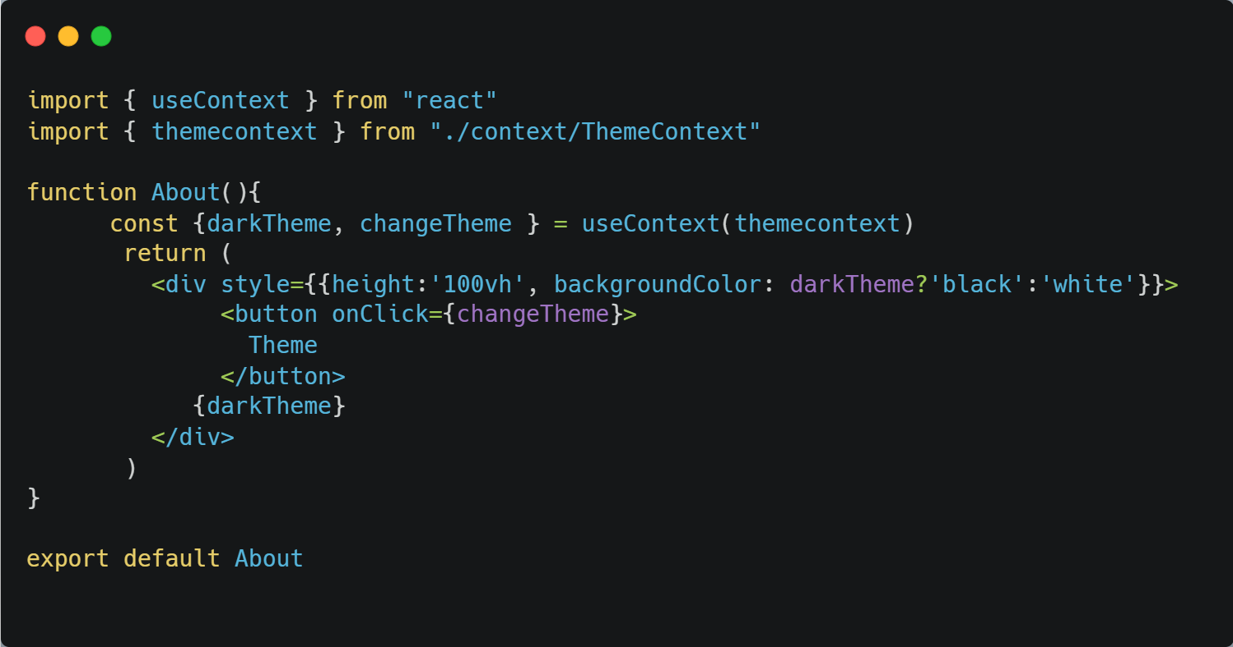
| Context api
About.jsx
What’s happening here:
useContext(themecontext) → pulls out the data from the ThemeContext provider.
{ darkTheme, changeTheme } → directly use the values we provided earlier.
backgroundColor: darkTheme ? 'black' : 'white' → dynamically changes page color based on theme.
<button onClick={changeTheme}> → toggles the theme when clicked.
This file is the consumer that actually uses the data from context.
23

Slide 24
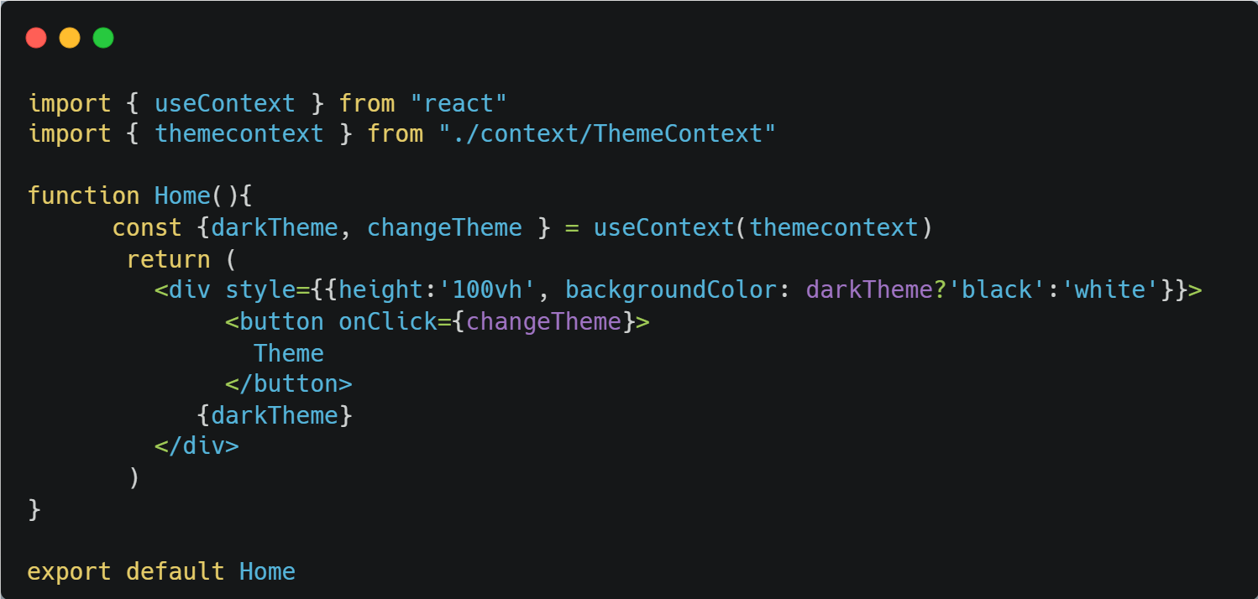
| Context api
Home.jsx
24

Slide 25

| Context api
Contact.jsx
25

Slide 26
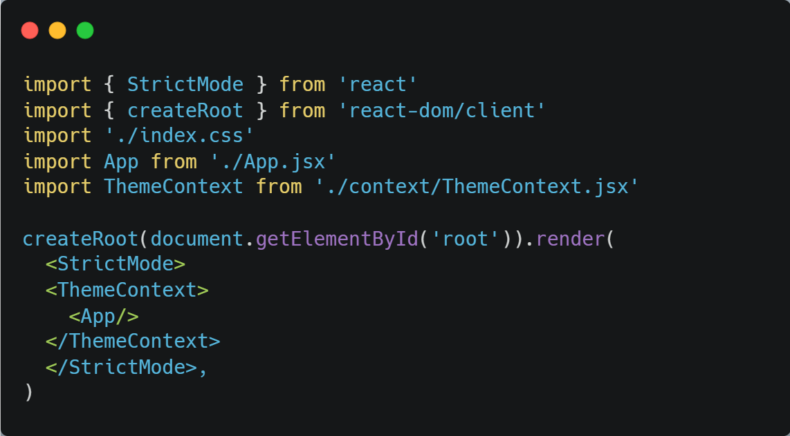
| Context api
index.jsx
What’s happening here:
We wrap <App /> inside <ThemeContext> provider.
This ensures that every component inside App can access darkTheme and changeTheme without prop drilling.
In short: This file connects everything together.
26

Slide 27
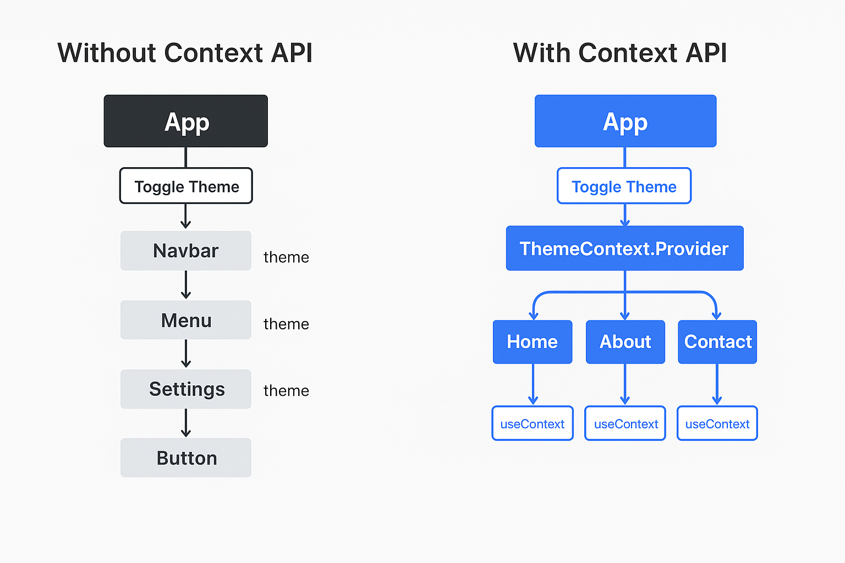
| Context api
Without Context API → Theme is passed manually to every component as props → messy & repetitive.
With Context API → Theme is available globally like Wi-Fi → any component can connect and use it directly.
27

Slide 28

| Coding Questions
1. Creating and Consuming a Simple Context
Task :
Create a ThemeContext that provides a simple string value (e.g., "dark"). In your App component, use the ThemeProvider to wrap a child component. In the child component, use the useContext hook to read and display the theme value.
28

Slide 29
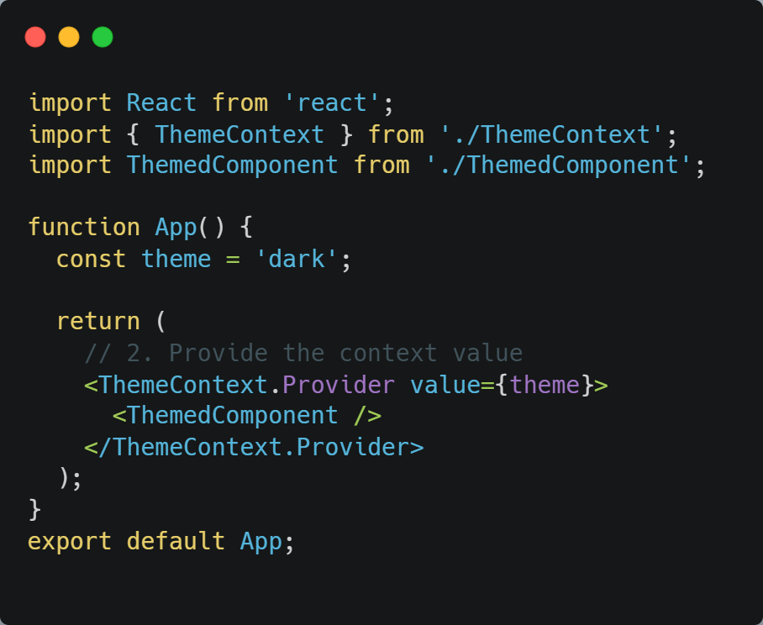
| Coding Questions
Solution :
src/App.jsx:

Slide 30
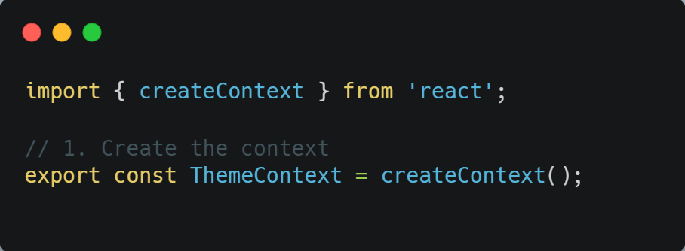
| Coding Questions
Solution :
src/ThemeContext.js:

Slide 31
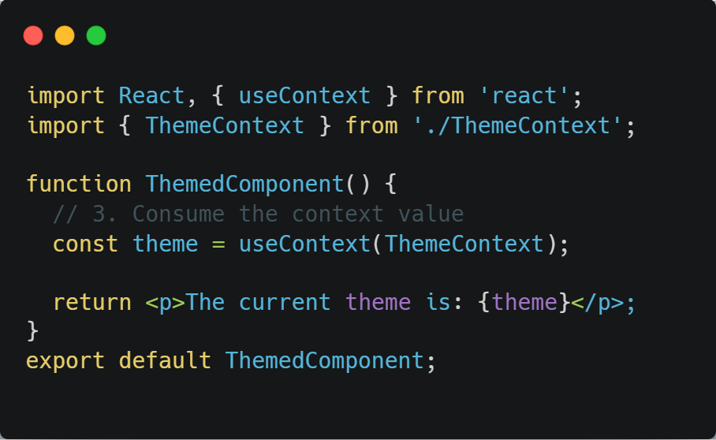
| Coding Questions
Solution :
src/ThemedComponent.jsx:

Slide 32
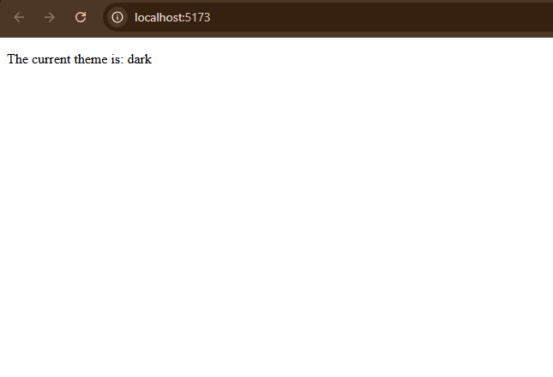
| Coding Questions
Output :

Slide 33
| Check Your Understanding
Question : What is "prop drilling" in React?
Options : a) A performance optimization technique.
b) The process of passing props down through multiple layers of nested components.
c) A method for creating new props dynamically.
d) A way to handle errors in props.
Answer : b) The process of passing props down through multiple layers of nested
components.
Explanation:
Prop drilling occurs when you have to pass data through intermediate components that don't need the data, just to get it to a deeply nested child component that does.

Slide 34
| Check Your Understanding
Question : What is the primary problem that the Context API solves?
Options : a) It makes it easier to style components.
b) It helps you avoid prop drilling by making data available to a tree of components without passing it manually at every level.
c) It replaces the useState hook for all state management.
d) It allows you to fetch data from an API.
Answer : b) It helps you avoid prop drilling by making data available to a tree of components
without passing it manually at every level.
Explanation:
Context provides a way to share values that are considered "global" for a tree of components, like the current user or theme, without passing props down the hierarchy.

Slide 35
| Check Your Understanding
Question : Which function is used to create a new Context object?
Options : a) React.useState()
b) React.newContext()
c) React.createContext()
d) React.useContext()
Answer : c) React.createContext()
Explanation:
Explanation: You start by calling createContext() to create a Context object. This object then gives you access to the Provider and is used by the consumer hook.

Slide 36
| Check Your Understanding
Question : How does a component make its context value available to all of its descendants?
Options : a) By calling a provide() function.
b) By returning a special <Provider> component and passing the data to its value prop.
c) By setting a global variable.
d) By using the useProvider() hook.
Answer : b) By returning a special <Provider> component and passing the data
to its value prop.
Explanation:
You must wrap the part of your component tree that needs access to the context with <MyContext.Provider value={...}>.

Slide 37
| Check Your Understanding
Question : How does a functional component consume (read) a value from a context?
Options : a) By accepting it as a prop.
b) By using the useContext hook and passing it the context object.
c) By querying the DOM for the provider.
d) By importing the value directly from the file where the context was created.
Answer : b) By using the useContext hook and passing it the context object.
Explanation:
The useContext(MyContext) hook is the standard and simplest way for a component to subscribe to context changes and get the latest context value.

Slide 38
| References
MDN Web Docs : Comprehensive and official documentation for JS. 🔗https://developer.mozilla.org/en-US/docs/Web/JavaScript
W3Schools – JS Tutorial : Beginner-friendly JS tutorials with examples and interactive editors. 🔗 https://www.w3schools.com/js/
react.dev - A comprehensive, tutorial-style website that deeply explores core React concepts, including components, state, effects, and hooks, through interactive examples and in-depth explanations.
🔗https://react.dev/

Slide 39
Thanks
For
Watching
Course - Web Development - II
welcome@krmangalam.edu.in
Sohna Road,Gurugram,Haryana 122103

